Slide 1
OUR JOURNEY IN PRIMARY 3

Slide 2
The School Day
8.45 - Door opens and children come straight into their classroom on their own
8.55 – Classroom door locks and lessons begin. Any lateness report to the front door
Collect children promptly at the end of each day
Monday 2.45pm
Tuesday, Wednesday & Thursday 2.15pm
Friday 2pm

Slide 3
What does my child need?
Wellington Boots
Backpack Plimsolls

Slide 4
School Dinners
School dinners are booked online using the School Money App
Dinners should be booked by Sunday night

Slide 5
We are a healthy eating school
Healthy Eating Policy (Website)
SNACK
1 or 2 healthy items for snack
Fruit & vegetables, yoghurt, crackers, breads, plain biscuits etc
No crisps/chocolate
Water/milk
Snack/packed lunch inspiration on the school website

Slide 6
Communication
Seesaw
Parent – teacher consultations
Open door policy
Book an appointment via Seesaw/school office
End of year progress report
School website

Slide 7
After School Activities All information for clubs sent via Seesaw
Sportstopia – multi-sports, football & dance
Ready for Anything (resilience building)
Clay Crazy
Play/Art Therapy
Lego Club
Counselling

Slide 8
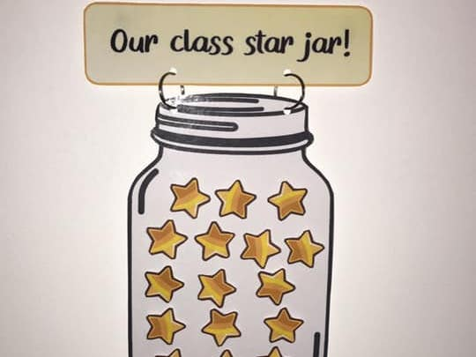
Positive Behaviour Policy available on our school website

Slide 9
Emotional Health and Wellbeing
Various strategies in place to support your child’s emotional health and wellbeing
Happy Healthy Minds

Slide 10
HOMEWORK
Written homework
Homework given out every Monday and returned every Thursday
Written Literacy and Numeracy
Topic-related Seesaw Class activity (starting in October)
Please sign completed written homework
Spellings and Maths Facts
Pupil Learning Book
Reading
Reading books given out every Monday and returned every Thursday
2 guided reading books and 1 unseen book each week
Online reading books allocated from Term 1B

Slide 11
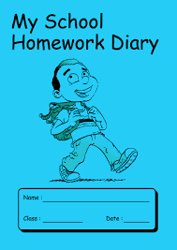
P3 Homework Day by Day Monday (new homework set) – written Literacy, reading, spellings, Maths facts Tuesday – written Numeracy, reading, spellings, Maths facts Wednesday – Seesaw Class activity, reading, spellings, Maths facts Thursday (homework returned) – online reading, Mathletics, revision for test

Slide 13
Literacy
Reading
Reading strategies
Fiction/non-fiction
Guided, shared and paired reading
Comprehension skills
Writing
Promote independence
Stories, poems, instructions, explanations etc
Accurate spelling
Neat, well presented
Talking and Listening
Show and Tell
Play and Tell
Presentations

Slide 14
PHONICS
Jolly Grammar
Our Primary 3 children will be following the ‘Jolly Grammar’ scheme. This is aimed at improving pupils’ spelling, punctuation and grammar.
Weekly spellings based on the scheme are part of the children’s homework and are informally tested every Friday.
Additional information and resources for home use are available on the school website.

Slide 15
Tricky and Sight Words
SIGHT WORDS
We teach the first 150 sight words to build pupils’ reading fluency
Sent home/links to the website
TRICKY WORD SPELLINGS
We encourage accurate spelling of tricky words in independent writing
Tips and ideas will be sent home

Slide 16
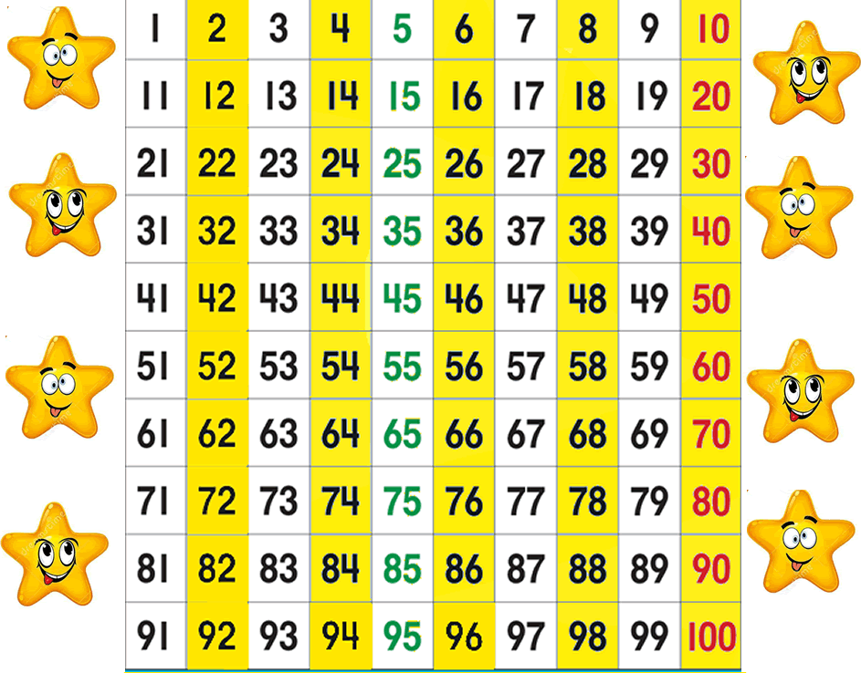
Numeracy
Mental Maths
We encourage quick recall of number facts
Number
Numbers to 100
Tens and units
Money to one pound
Counting patterns
Other Areas
Time – o’clock, half past, quarter past
Measure – introducing standard units of measure (metre, kilogram, litre)
2D and 3D shapes
Investigations
Problem-solving skills and strategies
(Thinking Skills and Personal Capabilities)
Mathletics
We use lots of practical materials when teaching new concepts to aid understanding

Slide 17
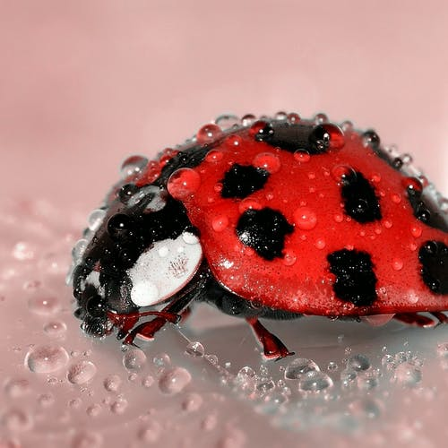
The World Around Us
Topics
Myself – bones, taste and sight
Birds – garden birds, birds of prey and penguins
Transport – transport through the ages, cars, aeroplanes, boats and the Titanic story
Minibeasts
Countries
Some of our topic sessions are taught through Forest school lessons/other outdoor learning opportunities

Slide 18
Exciting times for Dundela

Slide 19
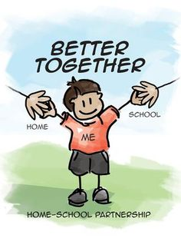
Thank you for coming along today!

