Slide 1
Welcome to P2
Mrs Bettes, Mrs Yau & Miss Harte
Mrs Kane & Mrs Boyd, Miss Dornan, Mrs Scott & Miss Greer
(Friday) (Mon, Thurs, Fri) (Tues & Wed)

Slide 2
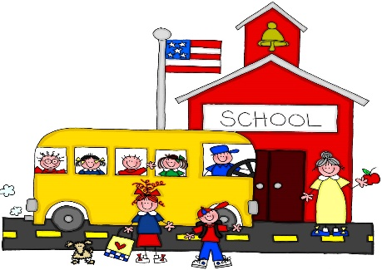
General Information
School day is 8.40am- 9am – 2pm-2.20pm – The staggered drop off is very important for parent social distancing measures.
PE Kit – PE shoes only at the minute.
Snack – small piece of fruit in a disposable wrapper/bag. Everyone should bring a water bottle with a sports cap to school every day.
We do not need a school bag at present – we will let you know if this changes.

Slide 3
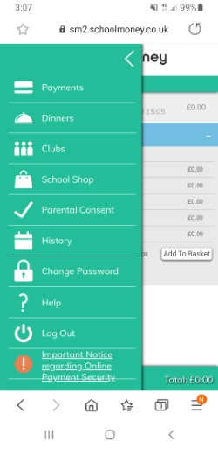
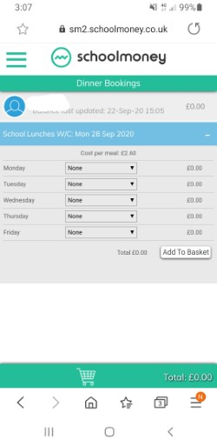
DINNER MONEY
Dinner money – These are now booked on the SCHOOL MONEY SYSTEM. Please do this by midnight on Sunday night for the week ahead.
If you cannot get logged on please email Mrs McKee and she will endeavour to help you.
Select dinners Then request meals on your chosen days

Slide 4
The return to school
We are very proud of how well the children have settled back into school life – We think they were just glad to see other children!
We can promise you we wash our hands A LOT!
We have adapted planning so that resources are not shared between the 3 P2 rooms without a suitable amount of ‘quarantine’ time or cleaning between activities.
We have also adapted our P2 ‘starting point’ to take into consideration what they missed in P1.
We are putting a lot of focus on children’s ‘Personal Development and Mutual Understanding’ within our school day – this is to ensure that the children are not worrying about anything, and if they are that they have strategies to deal with it. We are using a Yoga and Mindfulness programme to assist us in this. We have also worked hard during these early weeks to re-establish friendships.

Slide 5
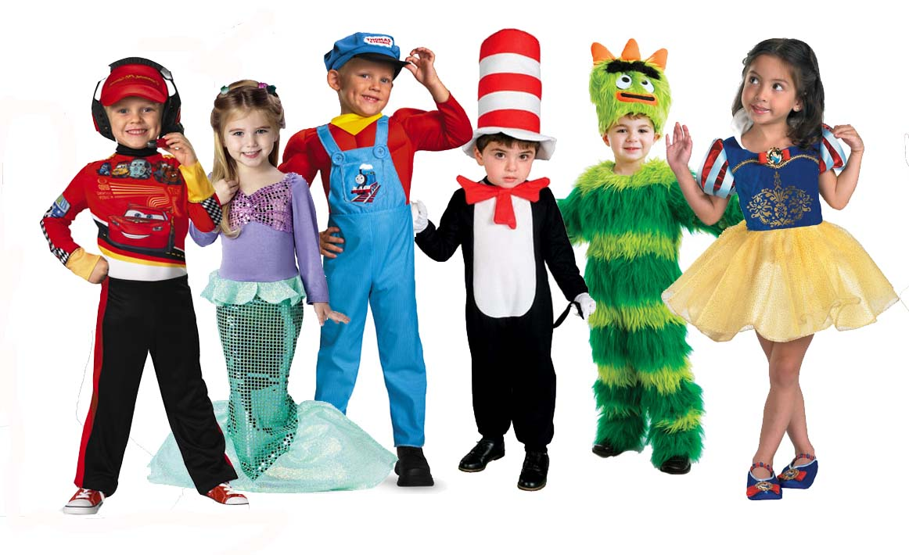
World Around Us & Play Based Learning – P2 Topics
Sharing stories
Space – unfortunately there will be no trip this year ☹
Celebrations
Toys
Growing Things
Pets and Vets
Pirates
Holidays

Slide 6
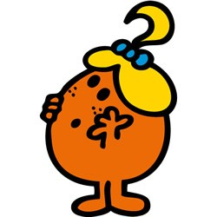
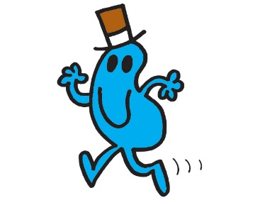
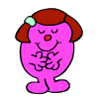
Thinking Skills and Personal Capabilities
5 Areas to develop
Working with Others – Mr Happy
Managing Information – Mr Good
Being Creative – Little Miss Curious
Thinking, Problem Solving and Decision Making – Mr Busy
Self Management – Little Miss Wise

Slide 7
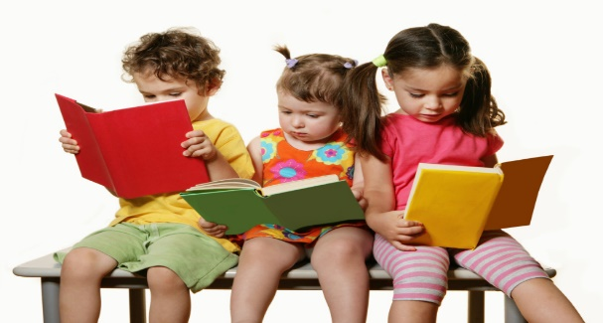
Literacy Reading
Groups are picked up from P1 at this stage, but movement between groups (up or down) can be expected – Baseline assessments are taking place right now to see what children are capable of.
When reading begins –your child will read in their group with the teacher, 2 days a week. Some reading homework will still be online. READING FOLDER INSTRUCTIONS WILL FOLLOW.
Other “fun reads” that come home are to build confidence and fluency. ( 1 per week)
Phonics –Covered every day in P2 - initial sounds revisited and beginning to word build – segmenting and blending. Phonics Bug (eBooks) will follow.
High Frequency Words – not “sounding out” words – we are teaching children to ‘Look, Say and spell’ these words.

Slide 8
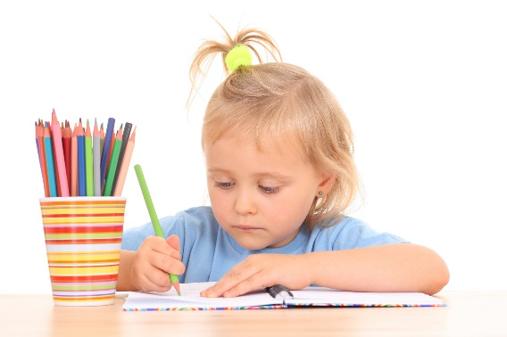
Literacy Writing
All children are encouraged to write independently, working at their level.
Letter formation is important .
Correct posture and pencil grip will greatly improve writing skills.
Children in P2 will write for many different purposes – during both Play Based Learning and more formal class teaching.
Phonetic spelling is acceptable, however we want the children to be able to write High Frequency Words independently and accurately as the year progresses.

Slide 9
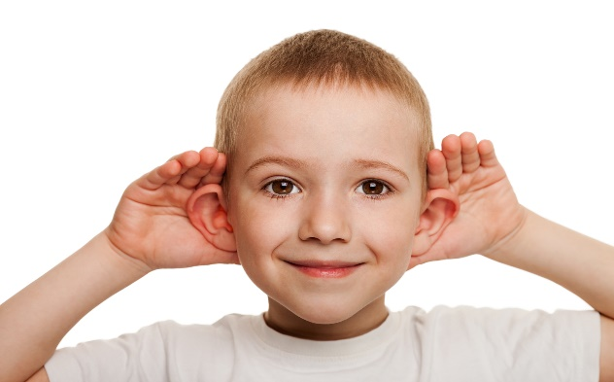
Literacy Talking and Listening
Talking and Listening skills are monitored and assessed.
Play and Tell, Read and Tell, Show and Tell are used throughout the year to improve these skills.
Opportunities will arise where they can share with peers, adults or the whole class.

Slide 10
Numeracy
Practical work makes up a lot of our Maths Group work
Mental Maths is used every day
The children are expected to work with the teacher, the classroom assistant and independently.
Areas covered – Number, Measures, Handling data, Shape & Space and ICT.
Number formation/reversals are also important.

Slide 11
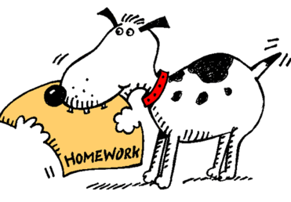
Homework in P2
Homework will come home on a Monday and should be returned to school on Thursday.
Homework will usually consist of a Literacy and a Numeracy task, along with words, sounds and and/or some mental maths. Please look after any resources sent home.
Oral and practical tasks are as important as written tasks.
Tasks will always be explained to the children before being sent home and will be appropriate for the level your child is working at.
Please spend 20-30 minutes (maximum!) each night on homework (including reading) – if you cannot complete tasks in this time please send a message to your teacher on Seesaw.

Slide 12
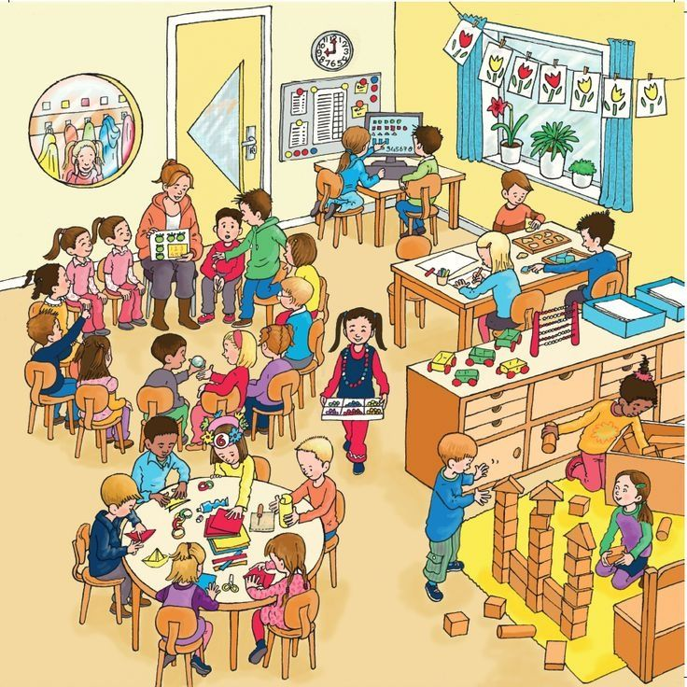
Meeting the needs of learners
Children have different skills, abilities and interests.
Children make progress at different rates.
Children learn best in different ways.
Please don’t compare your child with
others. Instead, praise them for trying
their best. This will build their
confidence.

Slide 13
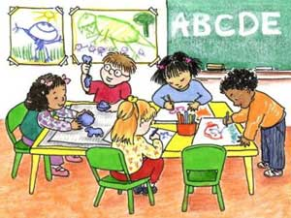
Supporting individual differences
Don’t worry if your child is provided with different work or activities from their classmates as this normal throughout schools.
Children learn differently and teachers are skilled professionals who will use a wide range of approaches to help the children learn best.
Teachers adapt lessons, the classroom,
materials and activities for the children.
In education this is called
differentiating the curriculum.

Slide 14
What to do if you are worried about your child’s progress
Many children experience difficulties with aspects of
their learning from time to time but only a small number
may have Special Educational Needs.
Many factors can impact upon a child’s progress in school. For example, changed home circumstances, illness or friendship fall-outs.
Always let the school know if you are aware of anything that is
upsetting your child or if you are concerned about their progress.

Slide 15
School website
www.dundelainfants.co.uk
Please make the website and Seesaw posts your first point of reference for times and dates!

Slide 16
REMEMBER…..
If a child feels happy and safe they are more likely to succeed in school.
WE ARE A TEAM! – We want the best for the children.

