Slide 1
Welcome to P2
Mrs Wright, Mrs Yau, Mrs Clement & Miss Morrison
Mrs Kane & Mrs Boyd, Mrs Scott & Mrs Tipping & Miss Dornan

Slide 2
General Information
School day is 8.55am – 2.10pm (Mon to Thurs) and 8.55am-1.55pm (Friday).
PE Kit – PE shoes only at the minute. If you can, please bring in a bag for PE shoes.
Snack – small piece of fruit or a plain biscuit. Everyone should bring a water bottle to school every day.
Green School Book Bags - this is important for getting reading folders and homework folders to and from school. Please add a keyring or something small to help your child identify their bag.
Please bring in a sock if you have not already.

Slide 3
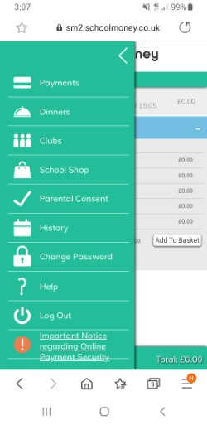
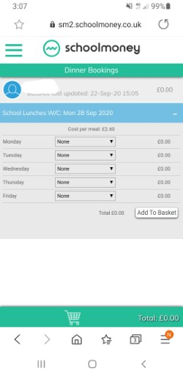
DINNER MONEY
Dinner money – These are booked on the SCHOOL MONEY SYSTEM. Please do this by midnight on Sunday night for the week ahead.
If you cannot get logged on please email Mrs McKee and she will endeavour to help you.
Select dinners then request meals on your chosen days

Slide 4
World Around Us & Play Based Learning – P2 Topics
Sharing is caring
Shops
Toys
Space
Jack and the Beanstalk
Pets and Vets
Pirates
Summer
We will also be outside for Outdoor Play and Forest School activities on a regular basis.

Slide 5
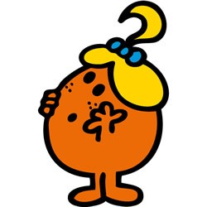
Thinking Skills and Personal Capabilities
5 Areas to develop
Working with Others – Mr Happy
Managing Information – Mr Good
Being Creative – Little Miss Curious
Thinking, Problem Solving and Decision Making – Mr Busy
Self Management – Little Miss Wise

Slide 6
Literacy Reading
Groups are picked up from P1 at this stage, but movement between groups (up or down) can be expected.
Reading – There will be 3 books per week. Reading folders must be sent to school each day so the next book can be added. The books will all be left in the folder until Thursday.
On Thursday an additional book will be sent via Seesaw.
Phonics – covered every day in P2 using the Jolly Phonics programme – we revisit initial sounds and continue to word build – segmenting and blending.
High Frequency Words – not “sounding out” words – children will learn to read and spell them to help their independent writing.

Slide 7
Literacy Writing
All children are encouraged to write independently, working at their level.
Correct letter formation is important .
Correct posture and pencil grip will greatly improve writing skills.
Children in P2 will write for many different purposes – during both Play Based Learning and more formal class teaching.
Phonetic spelling is acceptable, however we work towards children being able to write High Frequency Words independently and accurately as the year progresses.

Slide 8
Literacy Talking and Listening
Talking and Listening skills are monitored and assessed.
Play and Tell, Read and Tell, Show and Tell are used throughout the year to improve these skills.
Opportunities arise where they can share with peers, adults or the whole class.

Slide 9
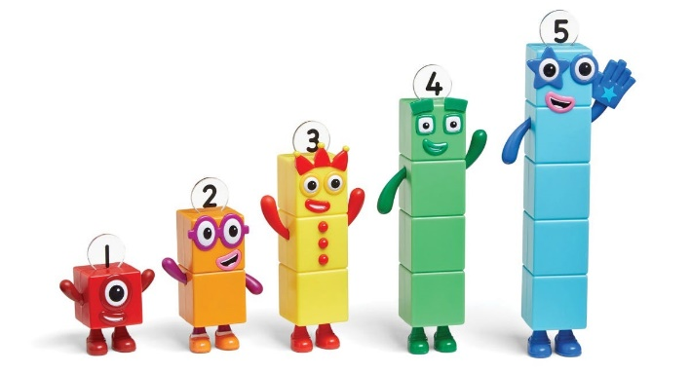
Numeracy
Practical work makes up a lot of our Maths Group work
We do mental maths every day.
The children are expected to work with the teacher, the classroom assistant and independently.
Areas covered – Number, Measures, Handling data, Shape & Space, ICT
Correct number formation is important (look out for reversals).

Slide 10
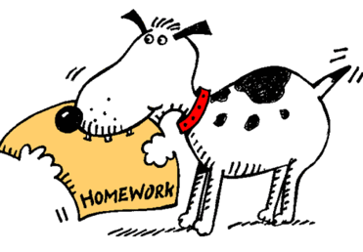
Homework in P2
Homework will come home on a Monday and should be returned to school on Thursday.
Homework will usually consist of a Literacy and a Numeracy task – these may be oral, practical or written tasks. – Please look after any resources sent home.
We will be using Education City for homework this year.
Tasks will always be explained to the children before being sent home and will be appropriate for the level your child is working at.
Please spend 20-30 minutes (maximum!) each night on homework (including reading).

Slide 11
Meeting the needs of learners
Children have different skills, abilities and interests.
Children make progress at different rates.
Children learn best in different ways.
Please don’t compare your child with others. Instead, praise them for trying their best. This will build their confidence.

Slide 12
Supporting individual differences
Don’t worry if your child is provided with different work or activities from their classmates as this is normal throughout schools.
Children learn differently and teachers are highly skilled professionals who will use a wide range of approaches to help the children learn best.
Teachers adapt lessons, the classroom, materials and activities for the children. In education this is called differentiating the curriculum.

Slide 13
What to do if you are worried about your child’s progress
Many children experience difficulties with aspects of their learning from time to time but only a small number may have Special Educational Needs.
Many factors can impact upon a child’s progress in school. For example, changed home circumstances, illness or friendship fall-outs.
Always let the school know if you are aware of anything that is upsetting your child or if you are concerned about their progress.

Slide 14
Parental involvement
Parent Interviews - Week beginning Monday 23rd October
Christmas Concert - Wednesday 13th December
P2 Open Classroom (stay and play) –
14th & 15th November
16th & 17th April

Slide 15
School website
www.dundelainfants.co.uk
Please make the website your first point of reference for times and dates!

Slide 16
REMEMBER…
If a child feels happy and safe they are more likely to succeed in school.
We all want the best for the children.

