Slide 1
Welcome to P2

Slide 2
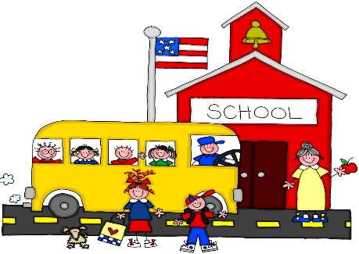
Mrs Clements
Miss Morrison
Miss Dornan
Miss McNeill

Slide 3
General Information
School day is 8.45am – 2.10pm (Mon to Thurs) and 8.45am-1.55pm (Friday)
PE Kit – PE shoes only at the minute.
Snack – small piece of fruit or a plain biscuit in a disposable wrapper/bag. Everyone should bring a water bottle with a sports cap to school every day.
Green School Book Bags - this is important for getting reading folders and homework folders to and from school. Please add a keyring or something small to help your child identify their bag.

Slide 4
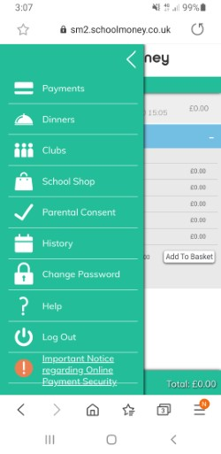
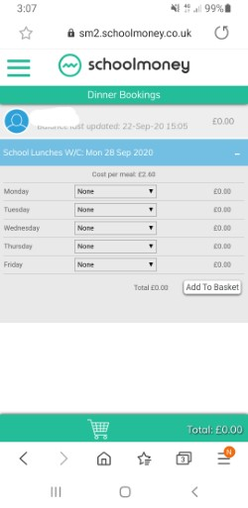
DINNER MONEY
Dinner money – These are now booked on the SCHOOL MONEY SYSTEM. Please do this by midnight on Sunday night for the week ahead.
If you cannot get logged on please email Mrs McKee and she will endeavour to help you.
Select dinners then request meals on your chosen days

Slide 5
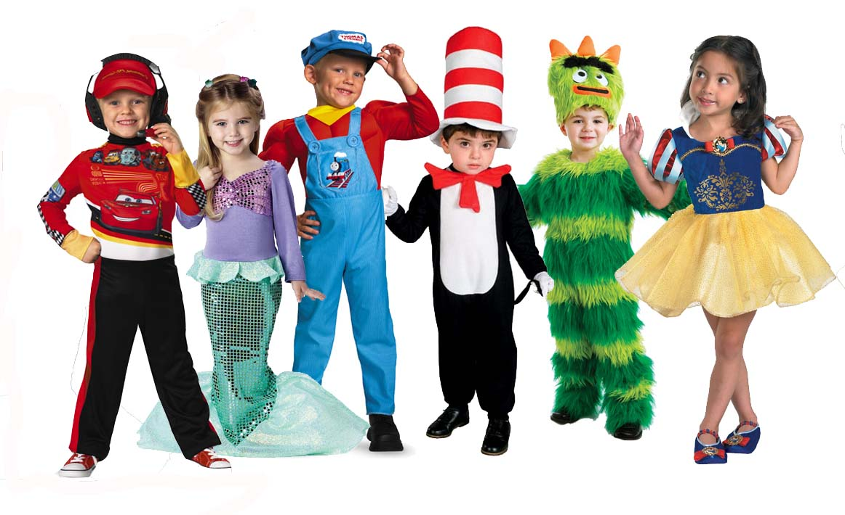
World Around Us & Play Based Learning – P2 Topics
Sharing is caring
Shops
Toys
Space
Jack and the Beanstalk
Pets and Vets
Pirates
Summer
We will also be outside for Outdoor Play and
Forest School activities on a regular basis

Slide 6
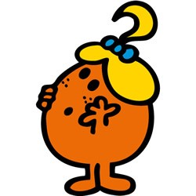
Thinking Skills and Personal Capabilities
5 Areas to develop
Working with Others – Mr Happy
Managing Information – Mr Good
Being Creative – Little Miss Curious
Thinking, Problem Solving and Decision Making – Mr Busy
Self Management – Little Miss Wise

Slide 7
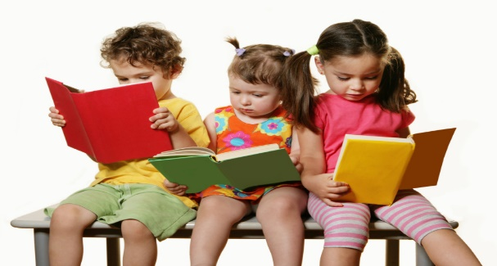
Literacy Reading
Groups are picked up from P1 at this stage, but movement between groups (up or down) can be expected – Baseline assessments will place to see what children are capable of.
READING – There will be 3 books per week. READING FOLDERS MUST BE SENT TO SCHOOL EACH DAY SO THE NEXT BOOK CAN BE ADDED. THE BOOKS WILL ALL BE LEFT IN THE FOLDER UNTIL FRIDAY.
Phonics –Covered every day in P2 through the Jolly Phonics programme - initial sounds revisited and continuing to word build – segmenting and blending.
High Frequency Words – not “sounding out” words – these will be taught to read and spell to help our independent writing.

Slide 8
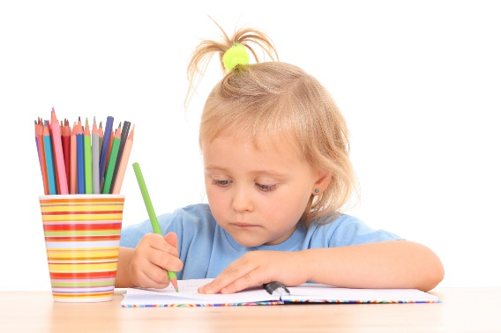
Literacy Writing
All children are encouraged to write independently, working at their level.
Letter formation is important .
Correct posture and pencil grip will greatly improve writing skills.
Children in P2 will write for many different purposes – during both Play Based Learning and more formal class teaching.
Phonetic spelling is acceptable, however we work towards children being able to write High Frequency Words independently and accurately as the year progresses.

Slide 9
Literacy Talking and Listening
Talking and Listening skills are monitored and assessed.
Play and Tell, Read and Tell, Show and Tell are used throughout the year to improve these skills.
Opportunities arise where they can share with peers, adults or the whole class.

Slide 10
Numeracy
Practical work makes up a lot of our Maths Group work
Mental Maths is used every day
The children are expected to work with the teacher, the classroom assistant and independently.
Areas covered – Number, Measures, Handling data, Shape & Space, ICT
Number formation/reversals are also important.

Slide 11
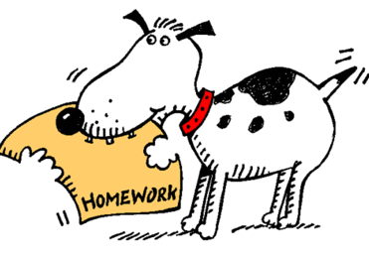
Homework in P2
Homework will come home on a Monday and should be returned to school on Thursday.
Homework will usually consist of a Literacy and a Numeracy task – these may be oral, practical or written tasks. – Please look after any resources sent home.
Education city - Online interactive activities https://www.educationcity.com/
Oral and practical tasks are as important as written tasks.
Tasks will always be explained to the children before being sent home and will be appropriate for the level your child is working at.
Please spend 20-30 minutes (maximum!) each night on homework (including reading) – if you cannot complete tasks in this time please send a message to your teacher on Seesaw.

Slide 12
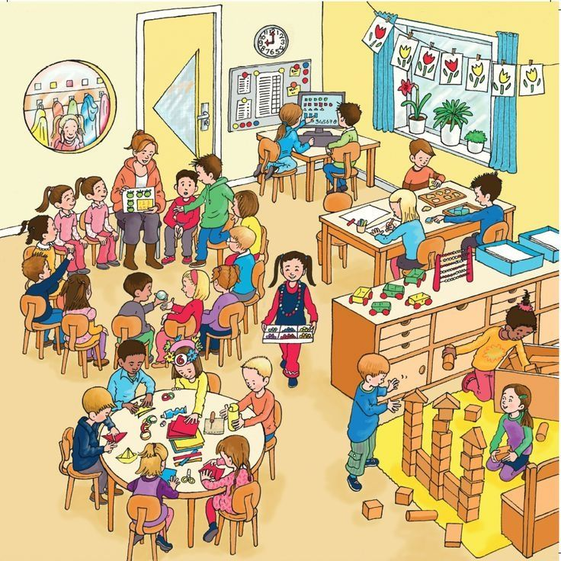
Meeting the needs of learners
Children have different skills, abilities and interests.
Children make progress at different rates.
Children learn best in different ways.
Please don’t compare your child with
others. Instead, praise them for trying
their best. This will build their
confidence.

Slide 13
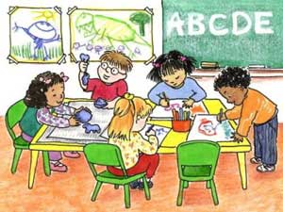
Supporting individual differences
Don’t worry if your child is provided with different work or activities from their classmates as this is normal throughout schools.
Children learn differently and teachers are highly skilled professionals who will use a wide range of approaches to help the children learn best.
Teachers adapt lessons, the classroom,
materials and activities for the children.
In education this is called
differentiating the curriculum.

Slide 14
What to do if you are worried about your child’s progress
Many children experience difficulties with aspects of
their learning from time to time but only a small number
may have Special Educational Needs.
Many factors can impact upon a child’s progress in school. For example, changed home circumstances, illness or friendship fall-outs.
Always let the school know if you are aware of anything that is
upsetting your child or if you are concerned about their progress.

Slide 15
Parental involvement
Parent Interview Week beginning –
Monday 23rd October
Christmas Concert - Wednesday 13th December
P2 Open Classroom (Stay and Play) –
14th & 15th November
16th & 17th April

Slide 16
School website
www.dundelainfants.co.uk
Please make the website your first point of reference for times and dates!

