Slide 1
Welcome to P2
Mrs Yau
Mrs Scott & Mrs Tipping (Thurs & Fri)
Mrs Wilson Mrs Wright

Slide 2
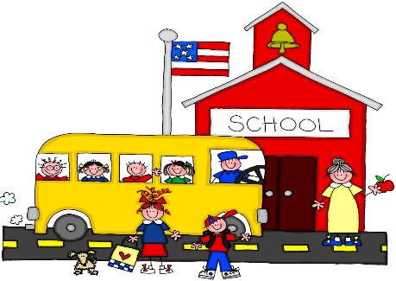
General Information
School day is 8.55am – 2.10pm (Mon to Thurs)
8.55am-1.55pm (Friday)
PE Kit – PE shoes only
Welly boots and coat
Snack – small and healthy
Bring a water bottle every day
Green School Book Bags - for reading/homework folders. Add a keyring or something small for quick identification
Name EVERYTHING!

Slide 3
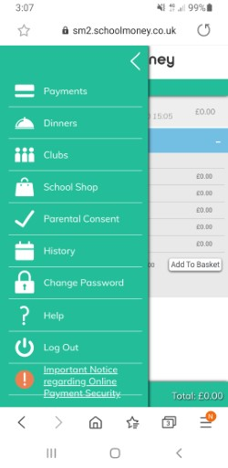
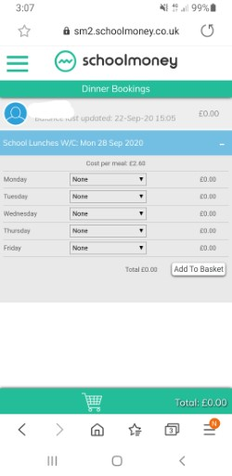
School MONEY
All payments - now booked on the SCHOOL MONEY SYSTEM. -by midnight on Sunday night for the week ahead.
If you cannot get logged on please email Mrs McKee and she will endeavour to help you.
Select dinners then request meals on your chosen days

Slide 4
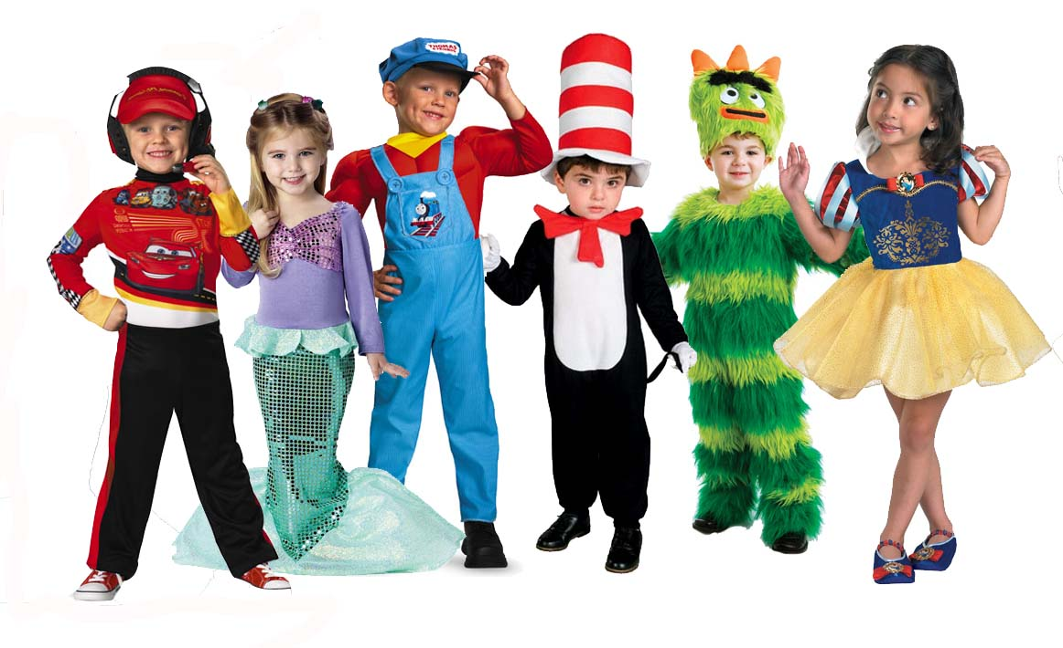
P2 Topics - World Around Us - Play Based Learning
Sharing stories
Space
Celebrations
Toys
Growing Things
Pets and Vets
Pirates
Holidays
We will also be outside for Outdoor Play and
Forest School activities on a regular basis

Slide 5
Thinking Skills and Personal Capabilities
5 Areas to develop
Working with Others – Mr Happy
Managing Information – Mr Good
Being Creative – Little Miss Curious
Thinking, Problem Solving and Decision Making – Mr Busy
Self Management – Little Miss Wise

Slide 6
Literacy Reading
Baseline assessments will place at the start of Oct.
READING – 3 books per week. - Thursday = Seesaw.
PHONICS – Jolly Phonics programme - initial sounds revisited - Continuing to word build – segmenting and blending
HFW – No “sounding out” - Taught to read and spell to help our independent writing.
Groups are picked up from P1, but movement between groups can be expected.

Slide 7
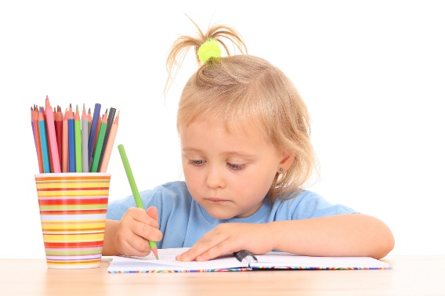
Literacy Writing
Encourage independence, working at own level
Letter formation is very important
Correct posture and pencil grip will greatly improve writing skills.
Will write for many purposes – in various settings
Phonetic spelling is acceptable, working towards being able to write HFW’s independently and accurately

Slide 8
Literacy Talking and Listening
Talking and Listening skills - monitored and assessed
Play and Tell, Read and Tell, Show and Tell are used throughout the year to improve these skills.
Opportunities created where they can share with peers, adults or the whole class.

Slide 9
Numeracy
Mental Maths every day
Group work 3 times a week
Areas covered – Number, Measures, Handling data, Shape & Space, ICT - Taught through other curricular areas
Number formation/reversals are also important.

Slide 10
Homework in P2
Sent home at start of week, return on Thursday
Usually a Literacy and a Numeracy task –may be oral, practical or written
Oral and practical tasks are just as important
Tasks explained and will be at appropriate level
Time?

Slide 11
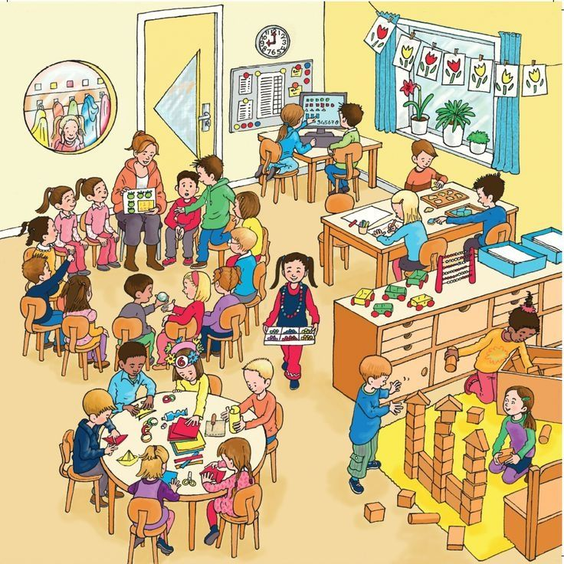
Meeting the needs of learners
Different skills, abilities and interests
Make progress at different rates
Learn best in different ways
Please don’t compare your child with others Instead, praise them for trying their best This will build confidence and self worth

Slide 12
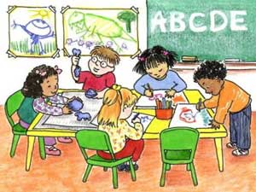
Supporting individual differences
Differentiated work – try not to compare
Children learn differently- many different approaches used
Every part of school is adapted!

Slide 13
What to do if you are worried about your child’s progress
Many children experience difficulties but only a small number may have Special Educational Needs
Other factors that impact upon a child’s learning. For example, changed home circumstances, illness or friendship fall-outs
Keep us informed, voice your concerns

Slide 14
Parental involvement
Parent Interview Week beginning –
Mon 23rd October
Christmas Concert - Wednesday 13th December
P2 Open Classroom –
14th/15th November
16th/17th April

Slide 15
School website
www.dundelainfants.co.uk
Your first point of reference for information!

Slide 16
REMEMBER…..
If a child feels happy and safe they are more likely to succeed in school.
We want the best for the children.

